Slide 1
Games Data Frame presentation

Slide 2
Agenda
Introduction
Understanding the data
Handling the data
Analyzing the Data

Slide 3

Today we will analyze together Games Data to understand the data and understand what does the market needs
Introduction

Slide 4
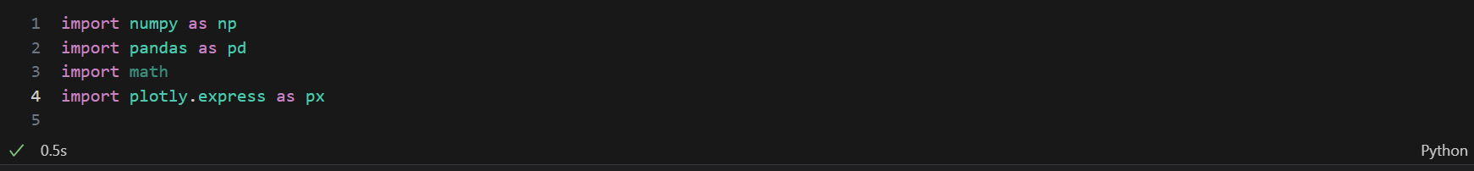
First Step Understanding the data
To understand the data we have to import some modules to help us analyzing the data

Slide 5
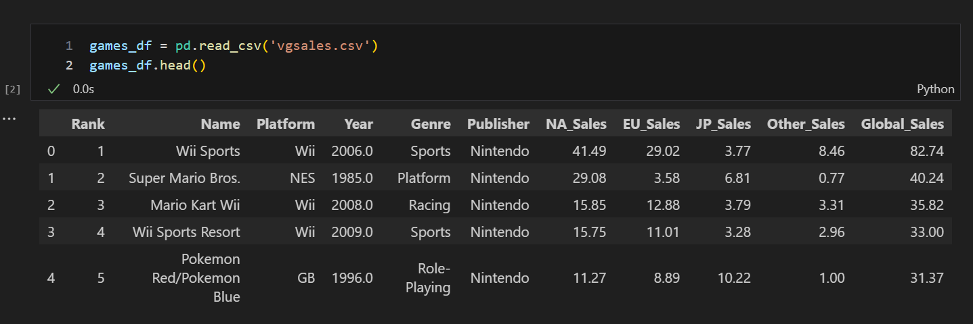
First Step we need to read the CSV using pandas and save it in DF Variable

Slide 6
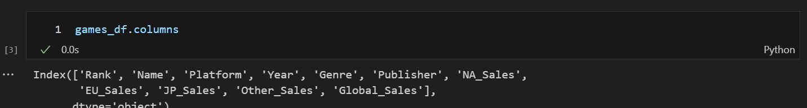
Now we will start Understanding to the Data
So first we need to Read the columns names to under stand what these data Contain

Slide 7

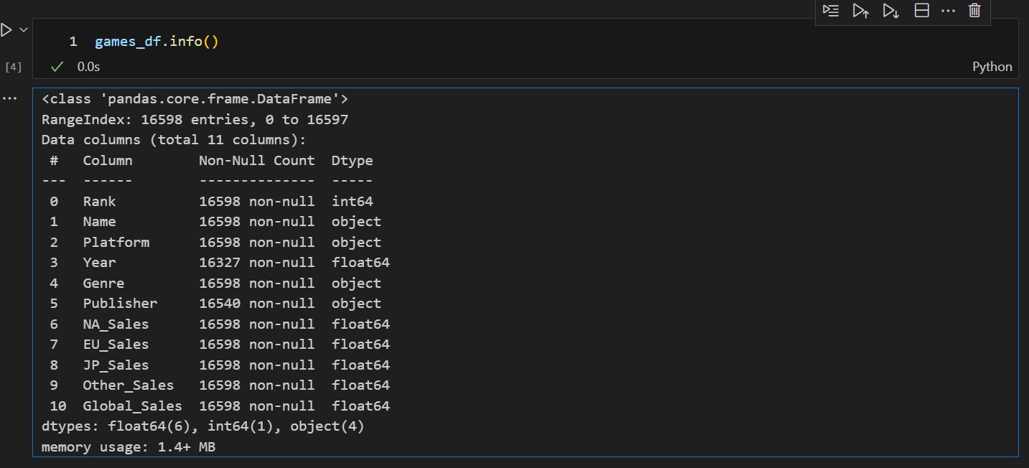
This code show information and the types every column of the Data Frame

Slide 8
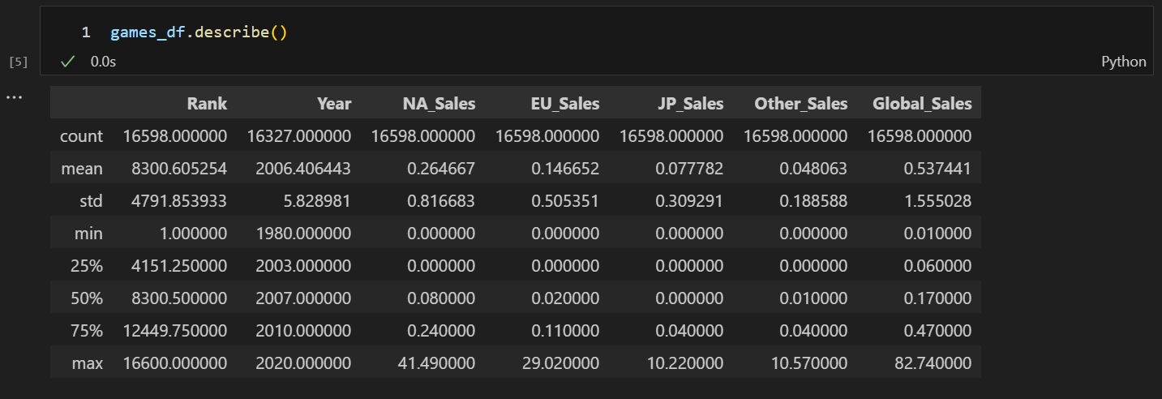
This code show all the agg functions for every numeric column which helps us understanding Numeric columns

Slide 9
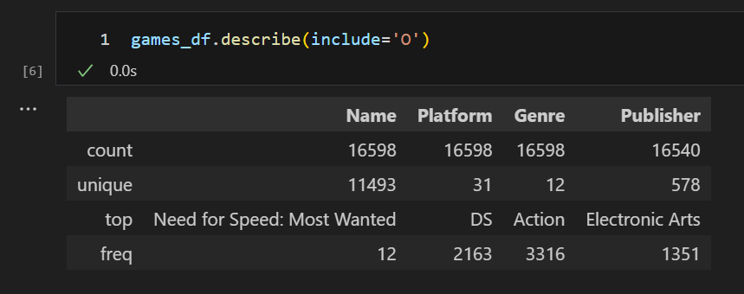
the code is generating descriptive statistics specifically for non-numeric columns (like names, platforms, genres, and publishers).

Slide 10
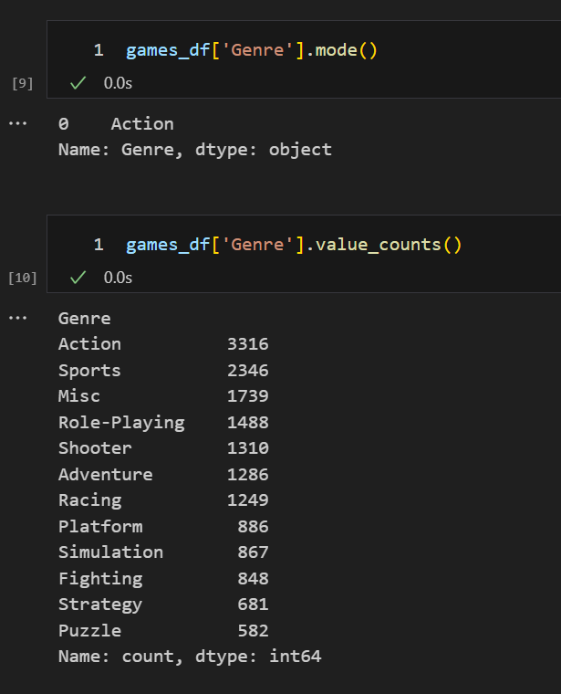
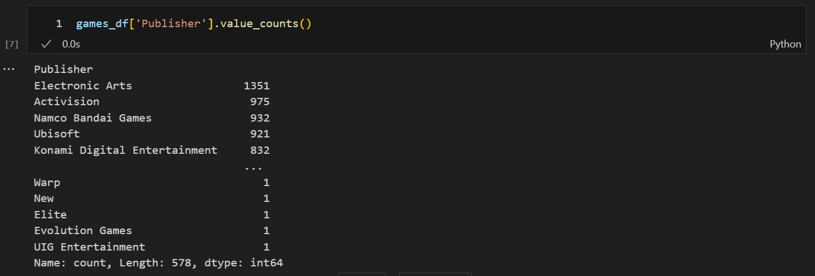
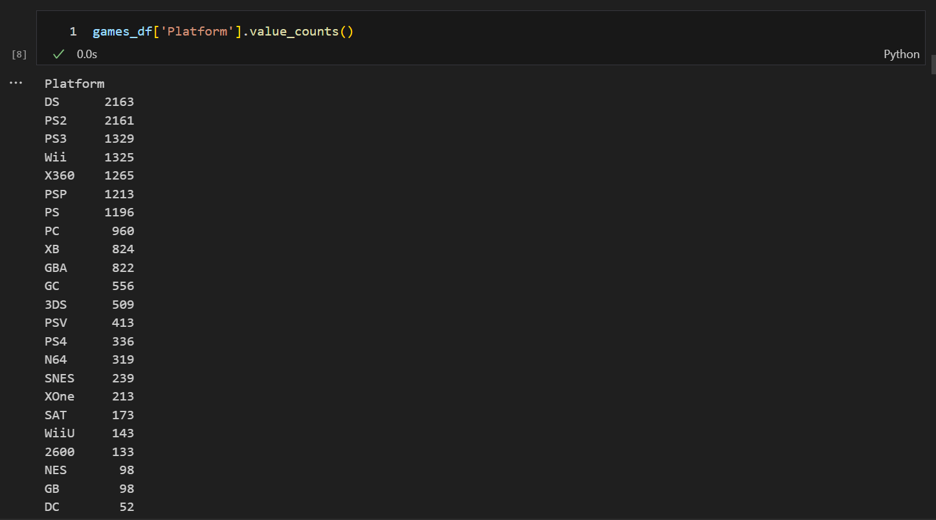
Using Functions like mode, value_count, etc to understand more about the data their data type is Object

Slide 11

Handling the Data
Improve and correct the wrong Data Types and handling the NAN

Slide 12
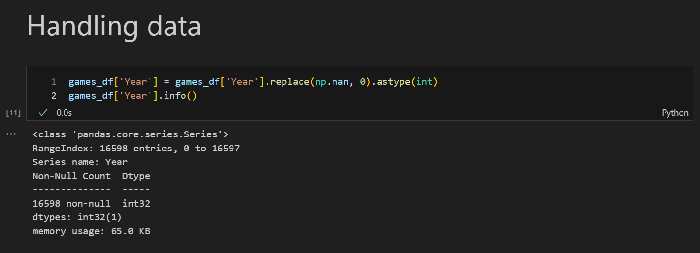
Handling The Data
This code is changing every nan with the value zeros ‘0’ In the Column named year and changing its data type to int instead of float

Slide 13
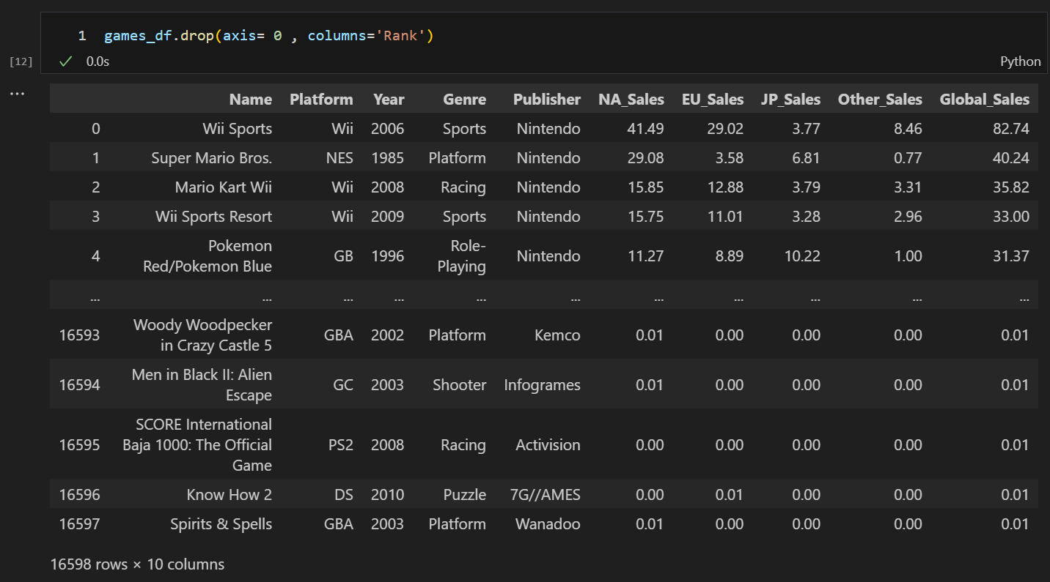
This code is function is to drop the column name Rank because its useless to us in analyzing theData

Slide 14
Navigating to Q&A sessions
Know your material in advance
Anticipate common questions
Rehearse your responses
Maintaining composure during the Q&A session is essential for projecting confidence and authority. Consider the following tips for staying composed:
Stay calm
Actively listen
Pause and reflect
Maintain eye contact

Slide 15
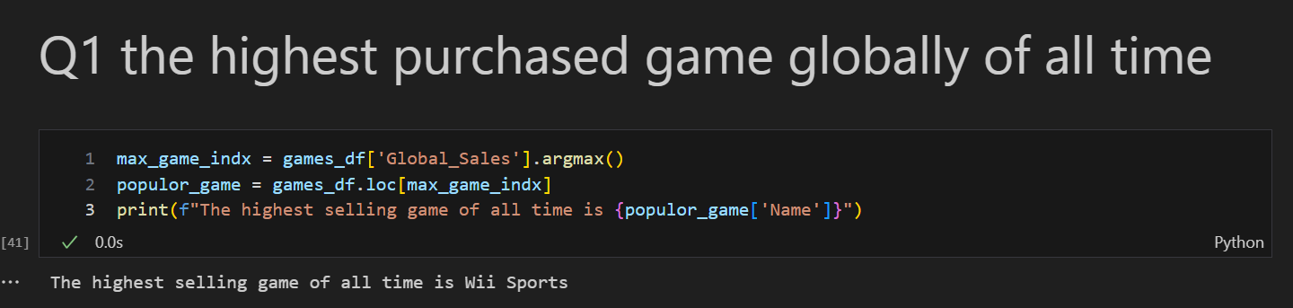
This code show to us the most profitable game compared to all game in this DF

Slide 16
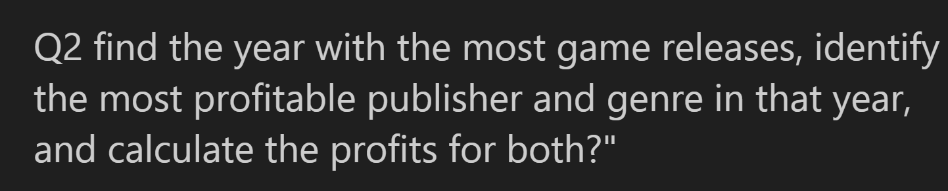

Slide 17
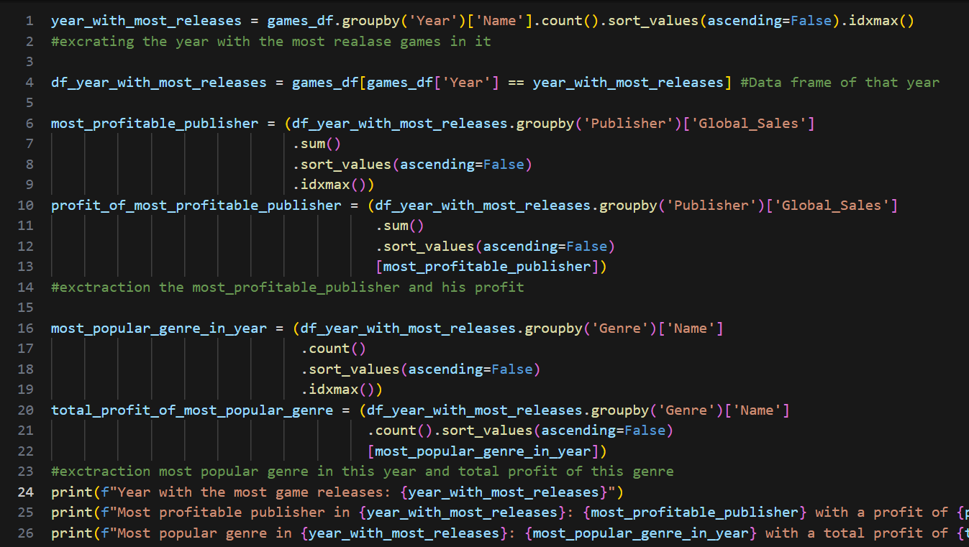

Slide 18
This is the result of the second Question

Slide 19
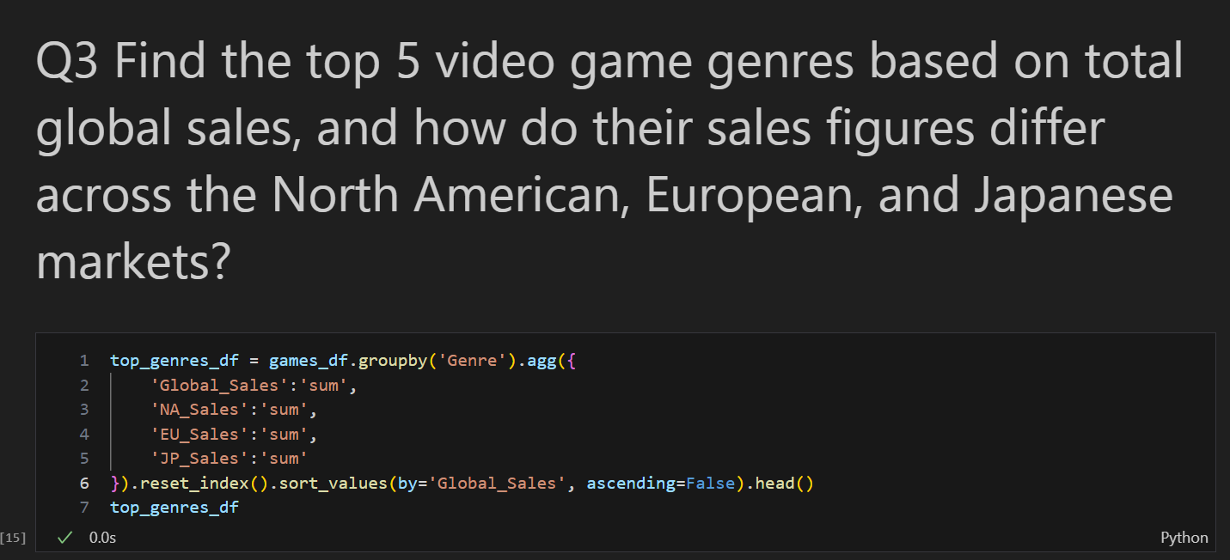

Slide 20
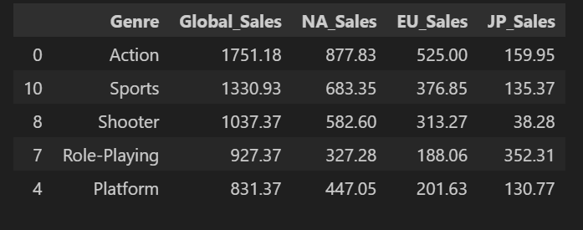
This is the result of code

Slide 21
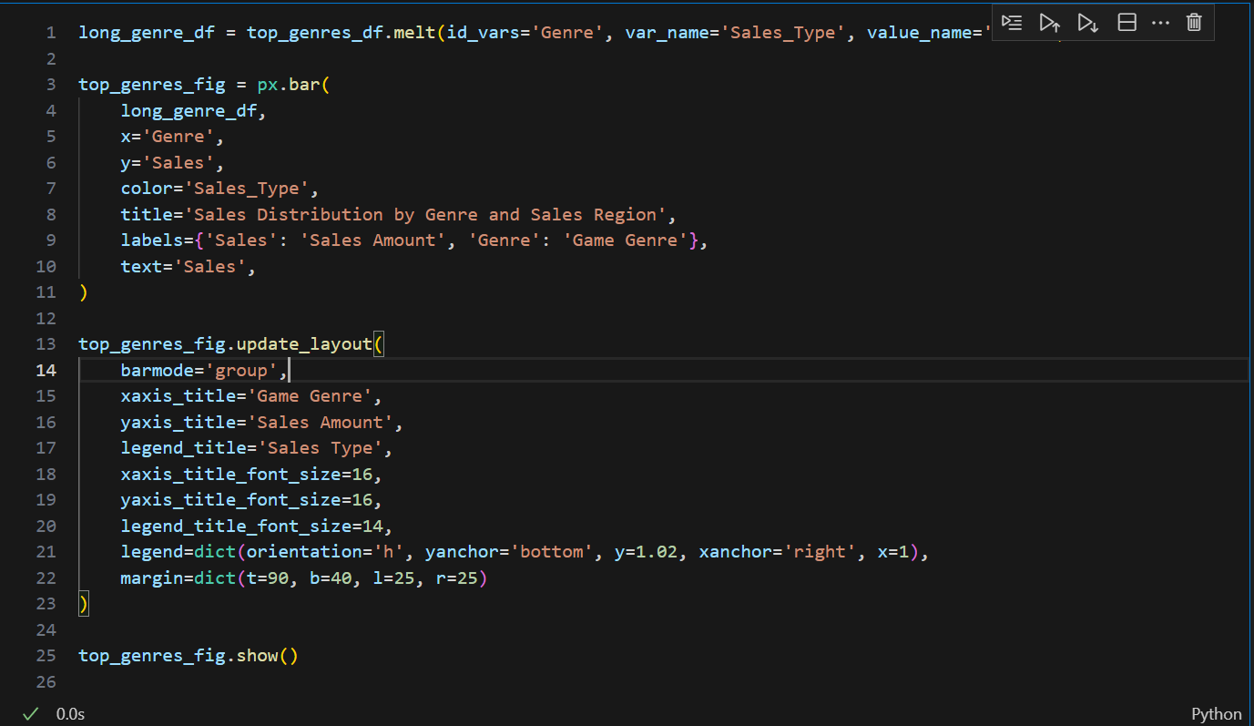
But it will be better to do a chart to analyze the data easier

Slide 22
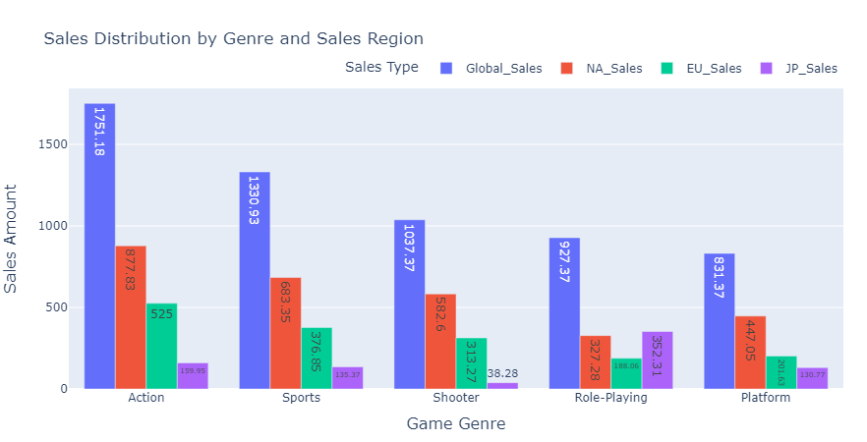
The Bar Chart

Slide 23
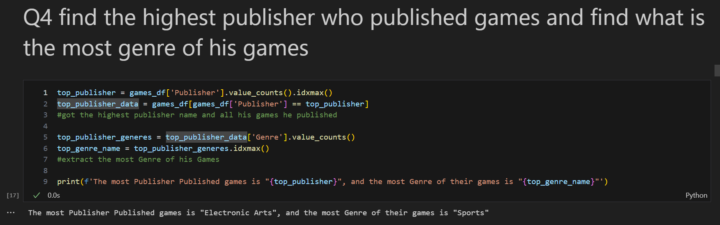

Slide 24
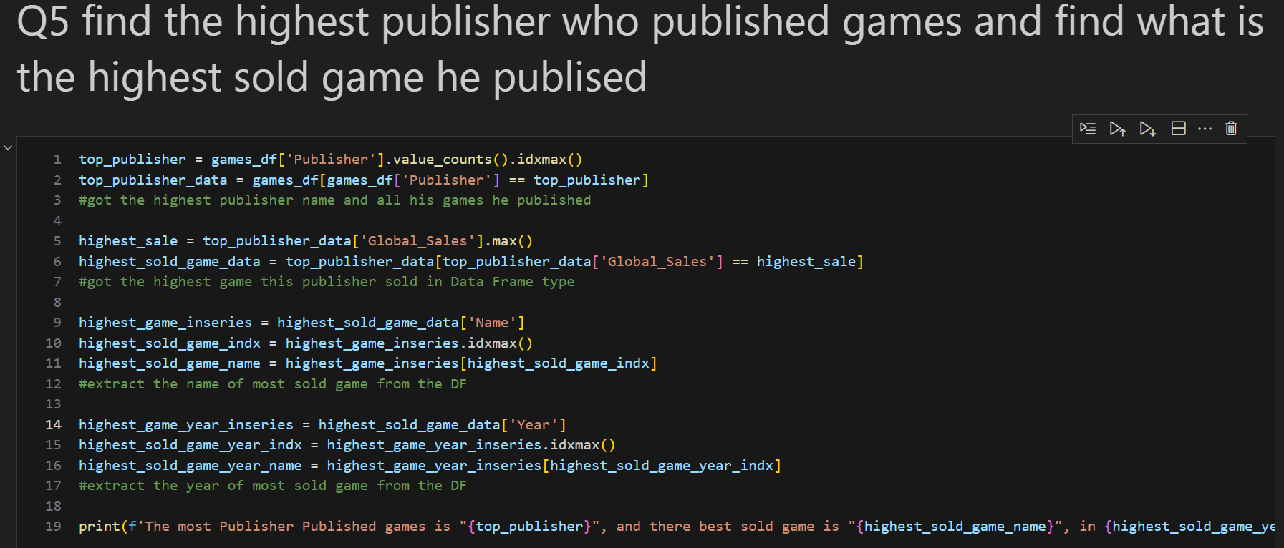

Slide 25
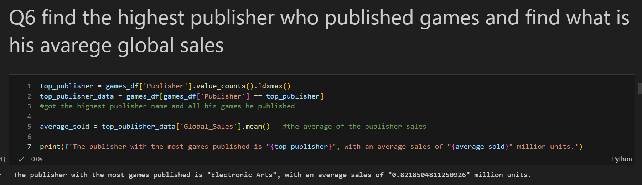

Slide 26
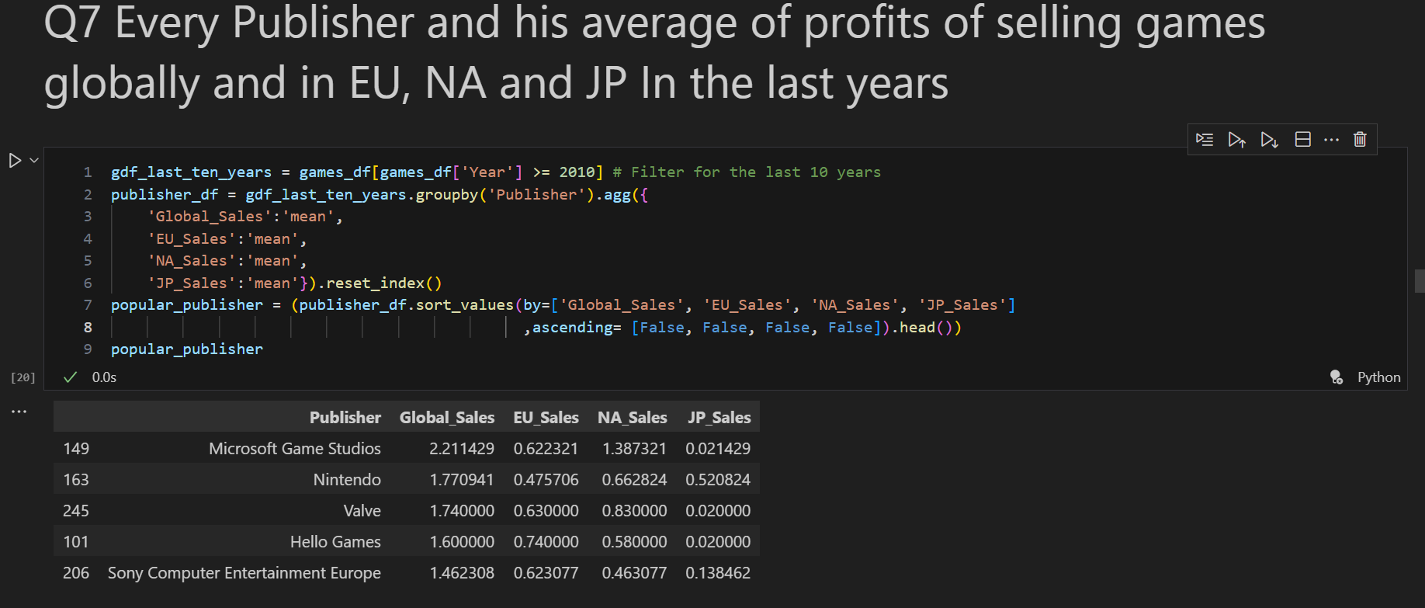

Slide 27
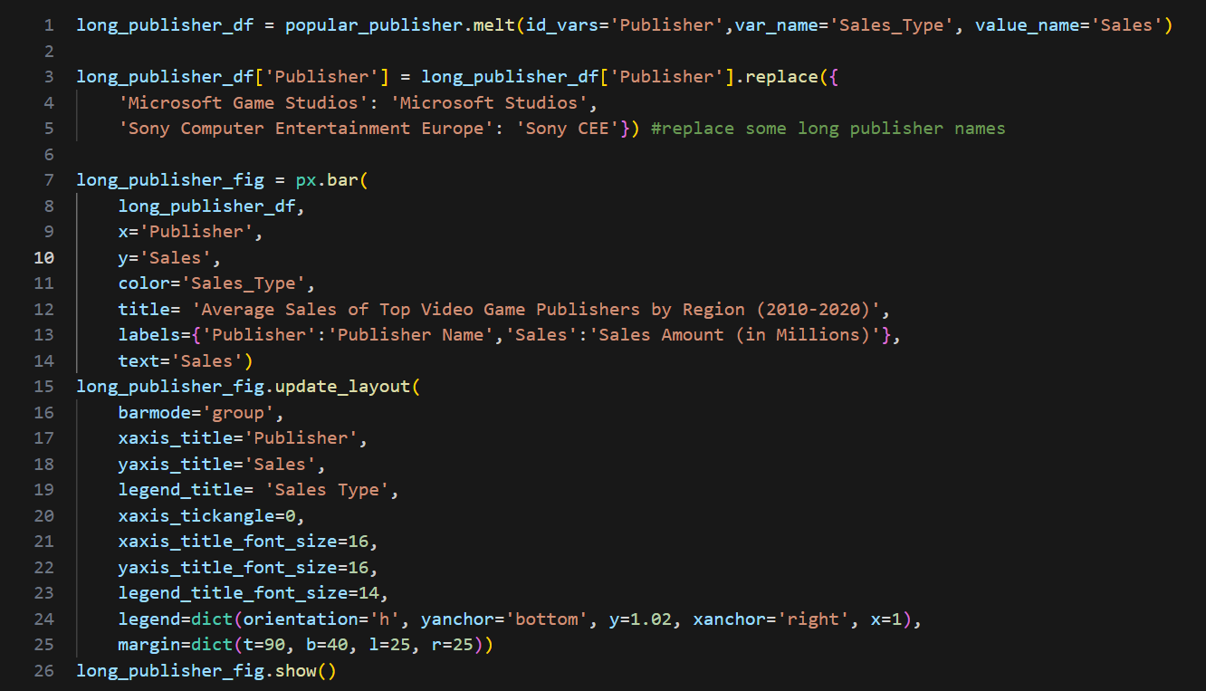
Let’s write a code to preview the result in Bar chart

Slide 28
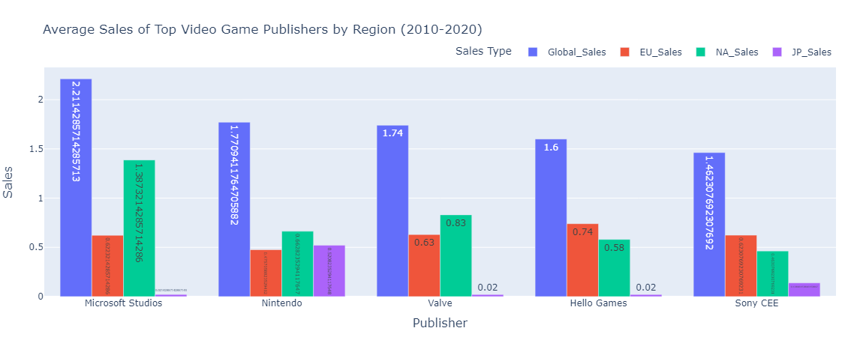
This is a chart represent the average profit by the top publisher from selling games

Slide 29
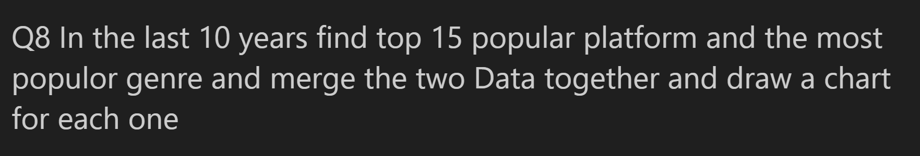
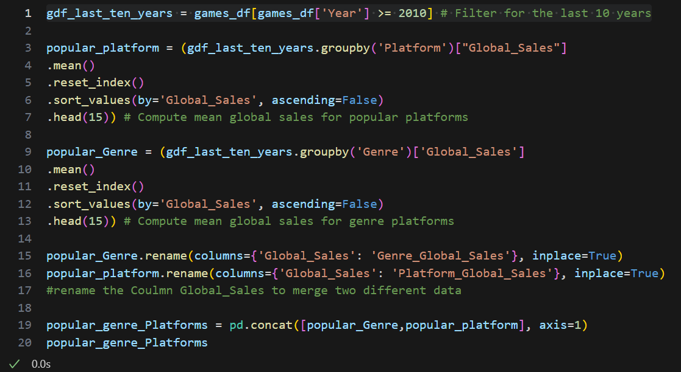

Slide 30
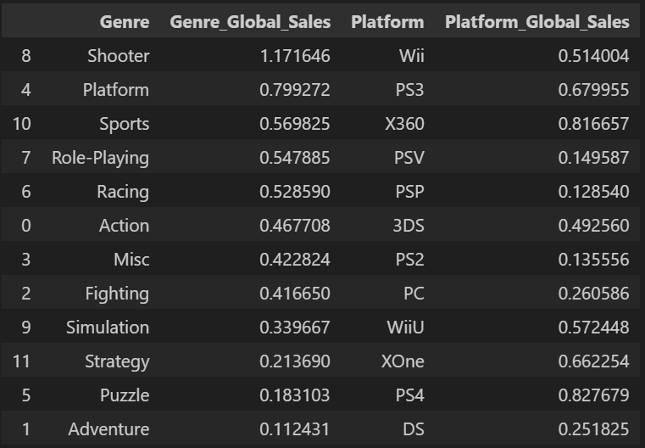

Slide 31
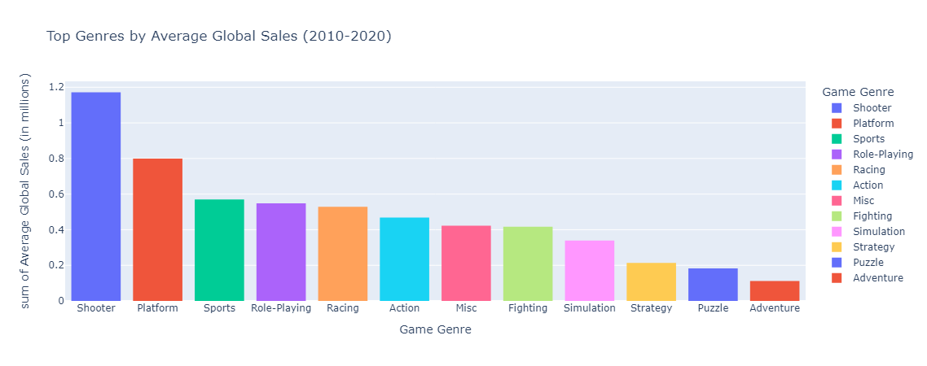
This is a chart represent the average profit of the top Genres Globally

Slide 32
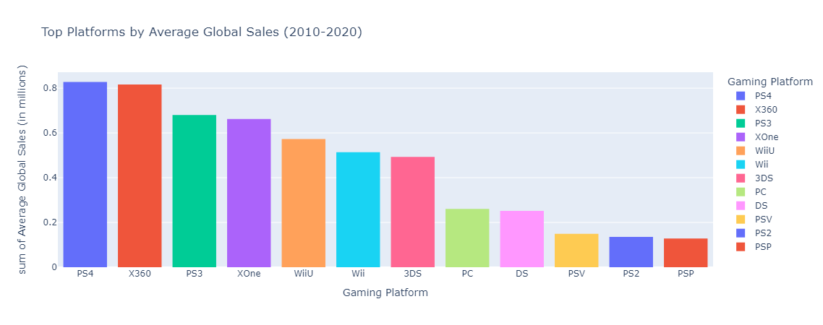
This is a chart represent the average profit of the top Platforms Globally

Slide 33
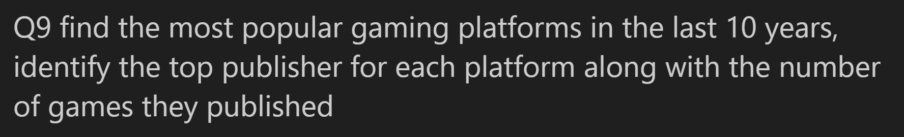
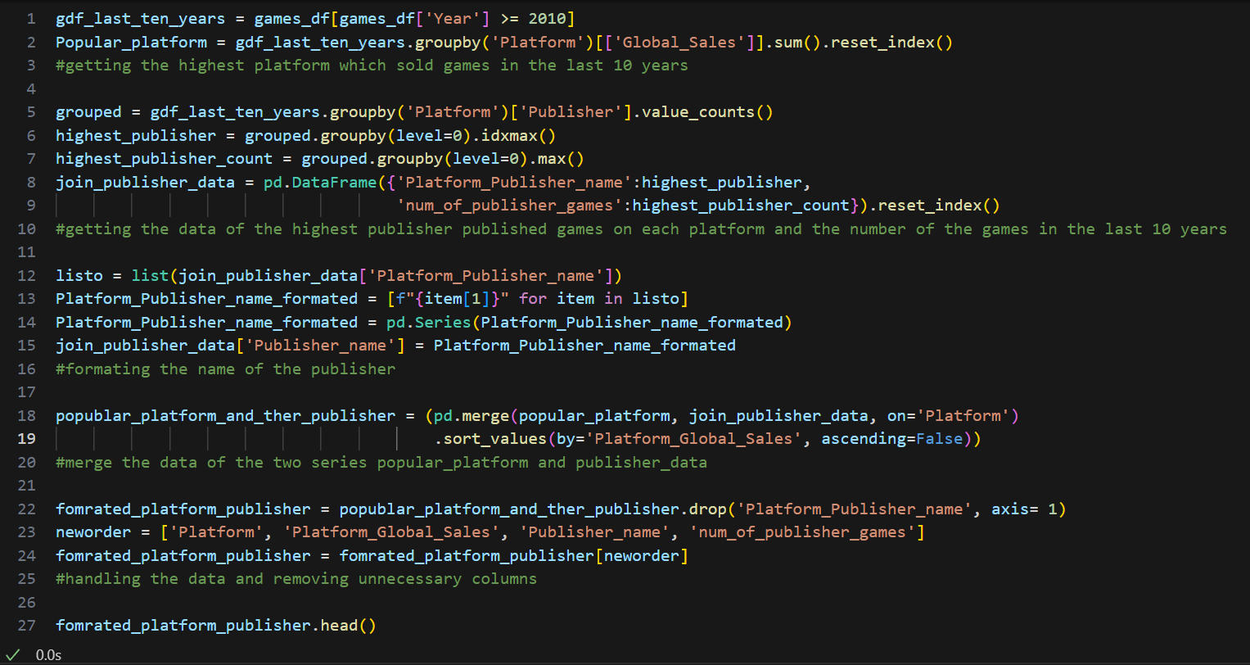

Slide 34
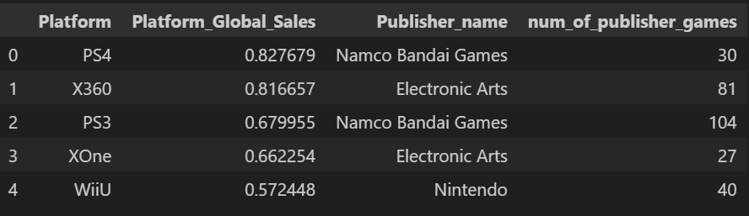
This is the result of the code why don’t we preview the data in chart to understand it better

Slide 35
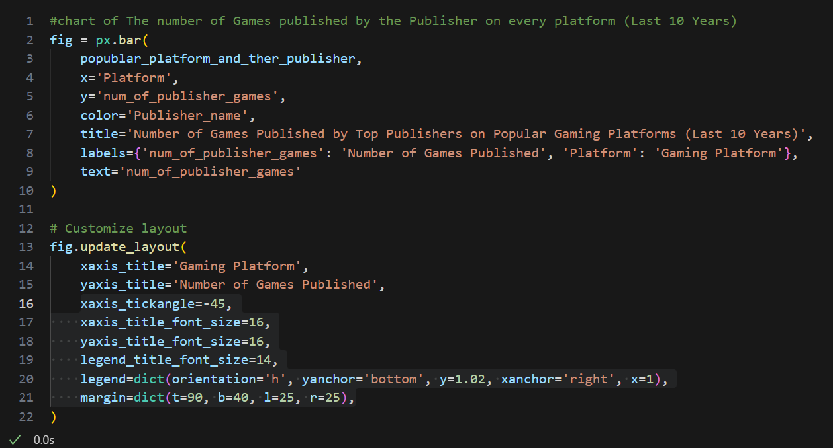
Let’s draw a chart shall we!

Slide 36
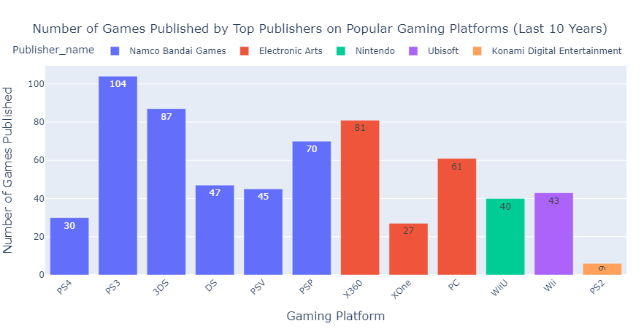

Slide 37
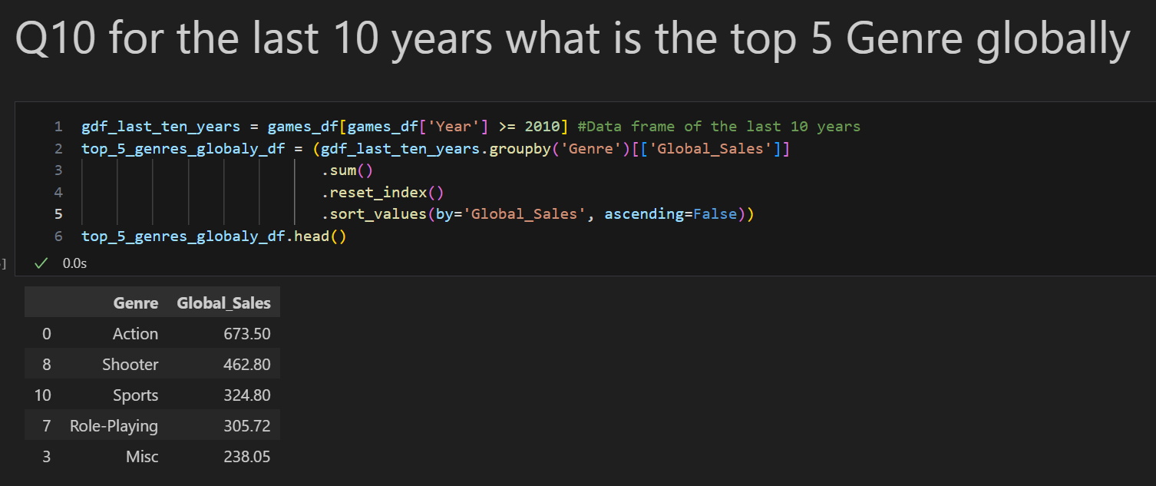
Let’s Draw a chart to represent the data

Slide 38
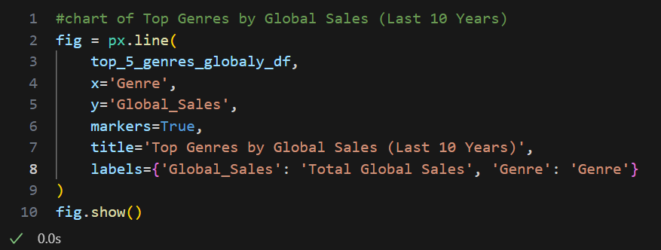
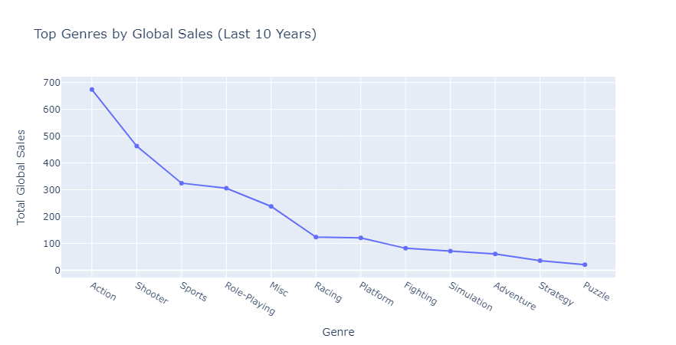

Slide 39
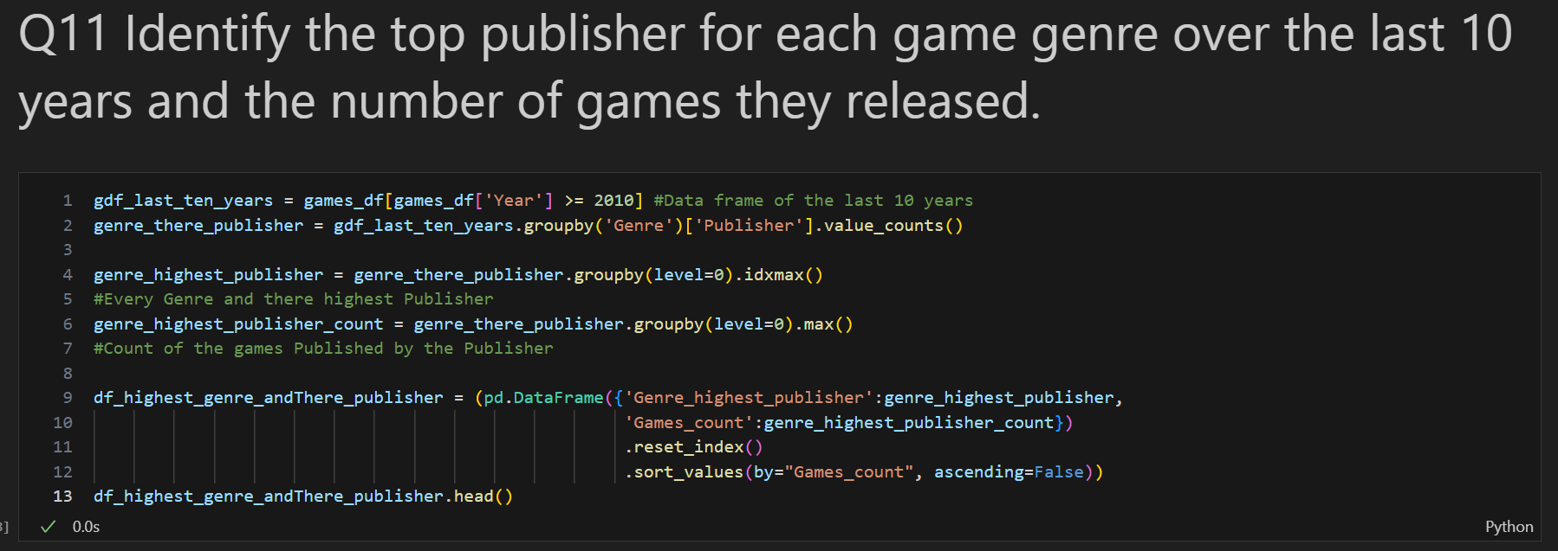
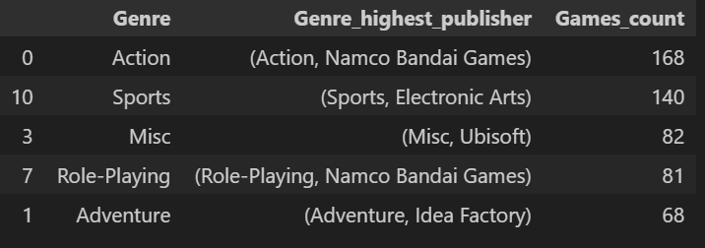
Chart?

Slide 40
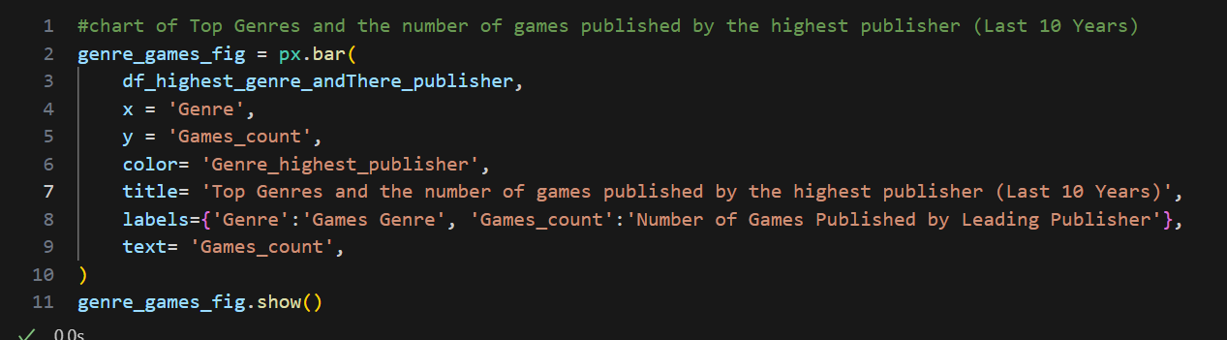
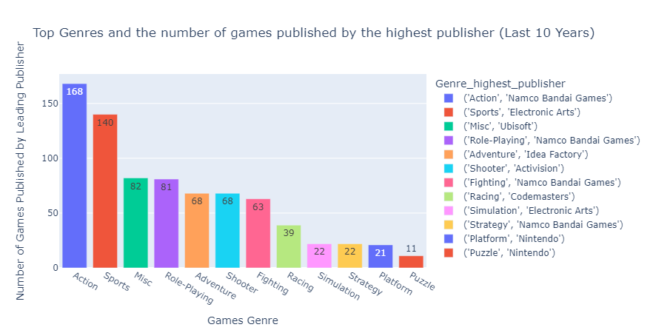

Slide 41
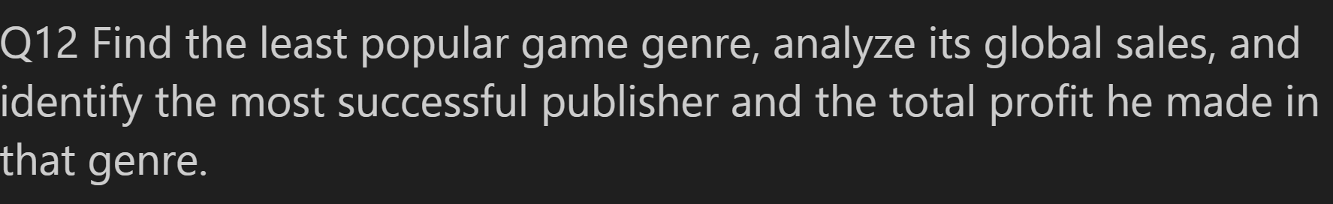
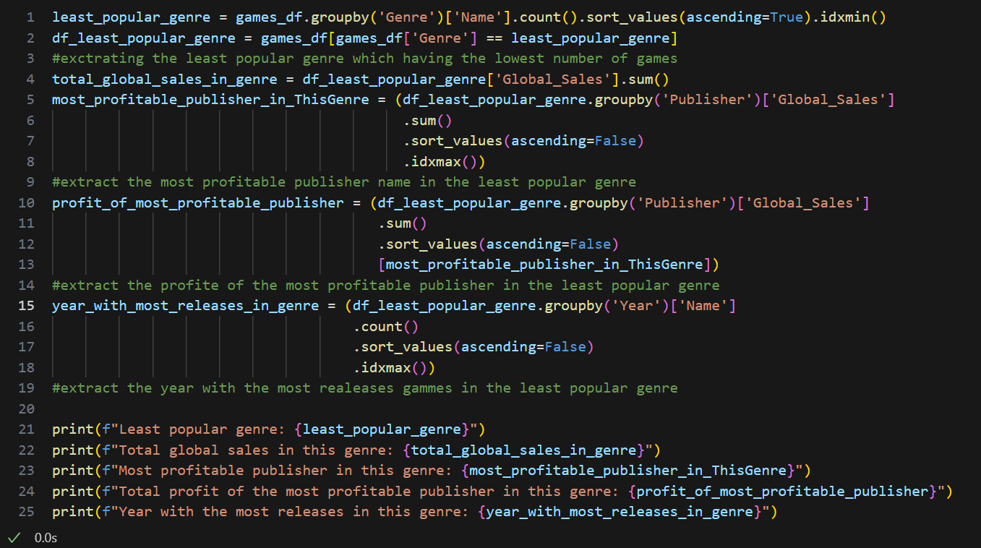
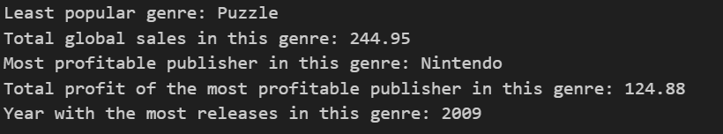

Slide 42
Thank you
Mostafa Saad Mostafa
https://github.com/mostafa-s-mostafa
https://www.linkedin.com/in/mostafa-saad-7a6b8a30b?utm_source=share&utm_campaign=share_via&utm_content=profile&utm_medium=ios_app
https://github.com/mostafa-s-mostafa

